Slide 1




STREAMAX
PARTNER ENABLEMENT
INHERENT CAN CAPABILITY
Vehicle CAN data, now built
into the dashcam you already sell.
One device. One $20 license. Activated remotely in FT Cloud — no separate GPS tracker, no external CAN box, no truck-roll.
$20 license
3,000+ vehicles
Remote activation
not a $60 device
decoded out of the box
zero truck-roll
STREAMAX · Inherent CAN Capability
Partner Enablement · 2026

Slide 2






02
01
THE OPPORTUNITY
Every fleet wants CAN data. Until now it cost them a second device.
Fuel, engine health, driver behaviour and fault codes are no longer nice-to-haves — buyers expect multi-domain vehicle intelligence from the box they already own. The blocker has always been hardware.
THE OLD WAY
A separate GPS tracker — just to read CAN
Fuel & consumption
Tank monitoring, theft chargeback, eco-driving
$60 / vehicle
Engine & powertrain
RPM, load, temperature, pedal positions
Extra hardware to buy, ship & install
Driver behaviour
Its own SIM, airtime & power wiring
Harsh events, over-revving, seatbelt, steering
Another box to fault-find and maintain
Predictive maintenance
A second data silo, separate from video
DTC fault codes, battery, odometer condition
STREAMAX · Inherent CAN Capability
Partner Enablement · 2026

Slide 3


03
02
THE SHIFT
Now CAN lives inside the dashcam itself.
The CAN decoding library is embedded directly in the AD Plus 2.0 firmware. The dashcam reads the raw vehicle bus and outputs clean, named parameters on its own — no translator box between the vehicle and the device.
No separate tracker
No external CAN box
Just a software license
CAN rides on the AI dashcam already in the cab.
The library replaces the old power-box hardware.
Inherent capability — switched on, not bolted on.
STREAMAX · Inherent CAN Capability
Partner Enablement · 2026

Slide 4

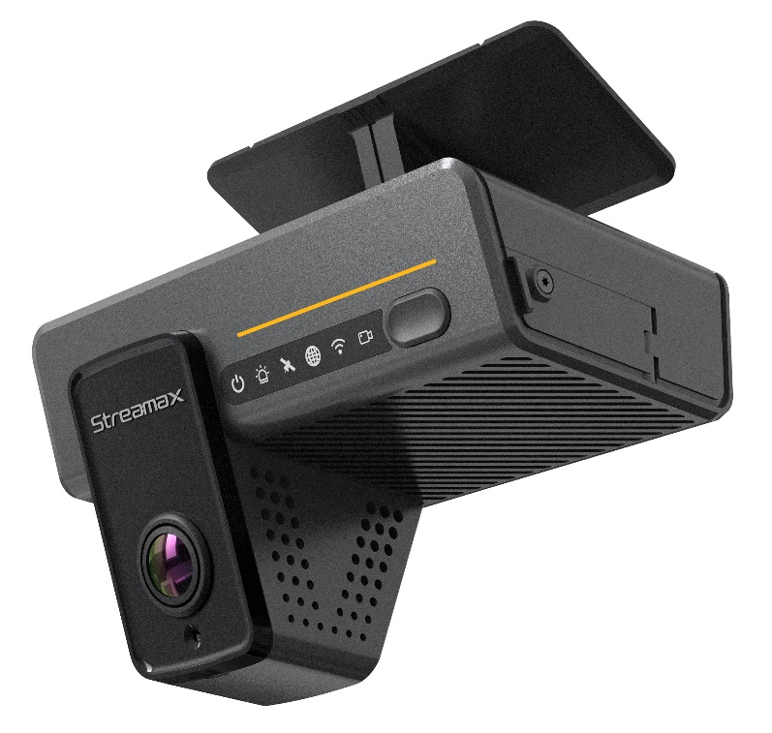






04
03
ONE DEVICE, ONE SIM
The extra tracker — and its SIM — simply disappear.
The old way meant a second box and a second SIM card. Both are gone — folded into the dashcam you already run.
TODAY'S SEPARATE HARDWARE
1 SIM only
STREAMAX
AD Plus 2.0
AI dashcam
Separate CAN tracker
its own box to install & maintain
−1 device
merges in
No separate CAN tracker to buy, fit or fault-find.
−1 SIM
2nd SIM + airtime
provision, top-up, manage, pay monthly
Video
AI
+ CAN
No second SIM to provision, top-up, manage — and no extra airtime bill.
✓ One device · One SIM · One bill
CAN now rides the dashcam's existing cellular link.
STREAMAX · Inherent CAN Capability
Partner Enablement · 2026

Slide 5


05
04
THE ECONOMICS
Same data. One third of the cost — and nothing extra to install.
SEPARATE GPS TRACKER WITH CAN
STREAMAX CAN LICENSE ON THE DASHCAM
$60 / vehicle
$20 / vehicle
VS
Dedicated tracker hardware
No new hardware — uses the AI dashcam
Second SIM + airtime
No extra SIM — shares the device link
Field install & wiring labour
No truck-roll — activated remotely
Separate platform / data silo
One platform — CAN beside the video
≈ $40 saved per vehicle — and the 2nd SIM, its airtime and admin go with the box.
STREAMAX · Inherent CAN Capability
Partner Enablement · 2026

Slide 6




06
05
WHAT'S IN IT FOR YOU
A high-margin software attach across your entire installed base.
CAN isn't a new box to stock — it's a license you switch on for dashcams you've already sold. Zero added BOM, zero logistics, recognised the same way as Safe GPT and Device AI.
Software-margin attach
Sell to the installed base
Nothing new to stock
Recurring & expandable
A $20 license on hardware already in the field — incremental revenue with no unit cost.
Every AD Plus 2.0 already deployed is a CAN upsell. No re-quote of hardware.
No trackers, SIMs or power-boxes to warehouse, ship, RMA or support.
Per-device activation, unified billing, and coverage that grows every year.
Position it simply: “You already bought the camera — turn on its CAN for $20 and skip the $60 tracker.”
STREAMAX · Inherent CAN Capability
Partner Enablement · 2026

Slide 7






07
06
HOW IT WORKS
Decoded on the device — clean named parameters into FT Cloud.
Vehicle CAN bus
AD Plus 2.0
FT Cloud
Dashboard / API
Raw, OEM-encoded signals on the in-vehicle network.
Embedded CAN library decodes raw bus into standard parameters — on-device.
Named parameters uploaded over the existing link; stored vs. vehicle & driver.
Customer sees CAN beside video — or pulls it via API. No backend mapping.
Why it matters: decoding happens in the camera, so FT Cloud receives clean, labelled values. No per-vehicle backend mapping, no external translator — and new vehicle coverage arrives as a firmware update.
STREAMAX · Inherent CAN Capability
Partner Enablement · 2026

Slide 8



08
07
WHAT YOU CAN SELL
24+ standardised parameters across five domains.
Vehicle identity
Powertrain & fuel
Environment & state
VIN
Make / Model / Year
Fuel level
Fuel consumption
Doors
Lamps
Odometer
Ignition status
RPM
Engine temp
GPS lat / long / time
Pedal positions
Safety systems
Driver behaviour
Seatbelt
DTC detection
Speed
Park brake
Steering wheel angle
Harsh accel / brake
Over-rev / idling
Exact availability varies by make / model / year — covered by per-vehicle support lookup before you quote.
STREAMAX · Inherent CAN Capability
Partner Enablement · 2026

Slide 9




09
08
USE CASES THAT CLOSE
Four high-value telematics use cases — out of the same license.
Fuel tank monitoring & theft
Fuel-efficient driving
Continuous fuel-level tracking flags abnormal drops in real time — chargeback evidence for siphoning.
Combine RPM, throttle, load and speed to score and coach drivers on idling and over-revving.
Fuel level · Ignition · GPS · Timestamp
RPM · Speed · Fuel consumption
Driver behaviour & risk
Predictive maintenance
Steering, pedal inputs and seatbelt status build a risk profile that complements ADAS events.
DTC codes plus engine and battery telemetry surface issues before failure — service by condition.
Steering · Seatbelt · Pedals
DTC · MIL · Engine temp · Battery
STREAMAX · Inherent CAN Capability
Partner Enablement · 2026

Slide 10



10
09
VEHICLE COVERAGE
3,000+ validated models — and a clear path for the rest.
Before you quote, the per-vehicle support lookup confirms:
3,000+
Where to tap the CAN bus
Exact installation points for that make / model / year.
vehicle models validated & tested
Which parameters are available
Per-vehicle parameter list for the precise MMY.
300–500 new models added every year
85+ countries with live deployments
Validation status & caveats
Tested coverage, with any known limitations flagged.
25+ years of CAN database heritage
Vehicle not listed yet? Two paths — wait for the batched annual coverage release, or commission an on-demand adaptation.
STREAMAX · Inherent CAN Capability
Partner Enablement · 2026

Slide 11
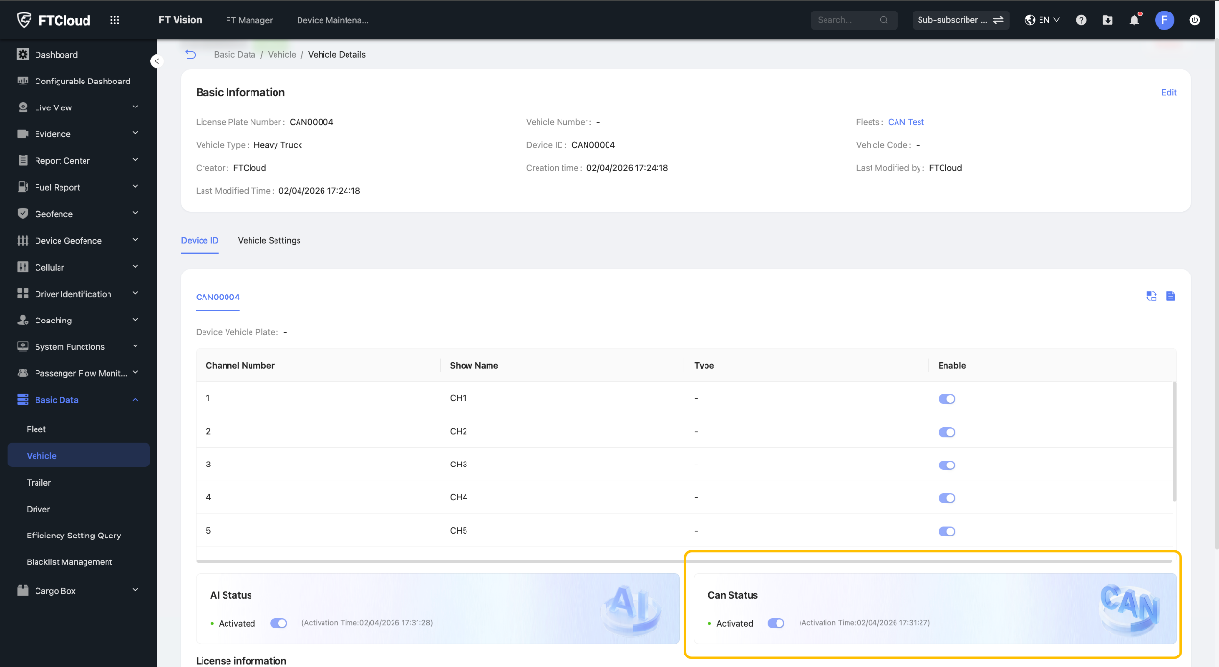



11
10
ACTIVATION IN FT CLOUD
Switched on remotely — self-serve, no on-site visit.
1
Self-serve activation
One device from Vehicle Details, or batch from the Vehicle List.
2
Task is queued
Issued to the device; track it in FT Manager → Can Activate Task.
3
Data starts flowing
Once active, decoded CAN parameters appear across FT Cloud.
4
Unified billing
Activated devices roll up in Report Center → Feature Activation Details.
Vehicle Details → CAN Status panel — one-click activation, with AI and CAN shown side by side.
Rollout: first on AD Plus 2.0 (software upgrade + per-vehicle support check), more models to follow. Requires FT Cloud V3.18.2 or later.
STREAMAX · Inherent CAN Capability
Partner Enablement · 2026

Slide 12
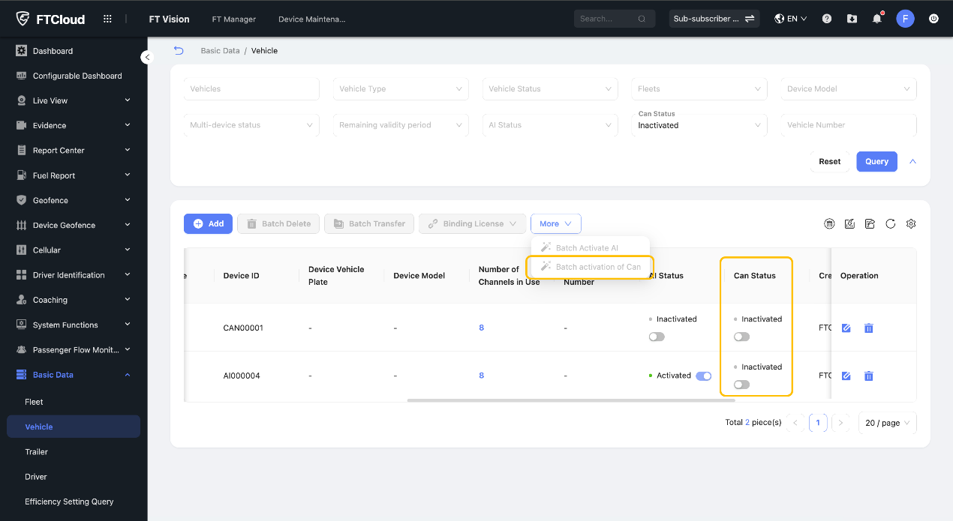
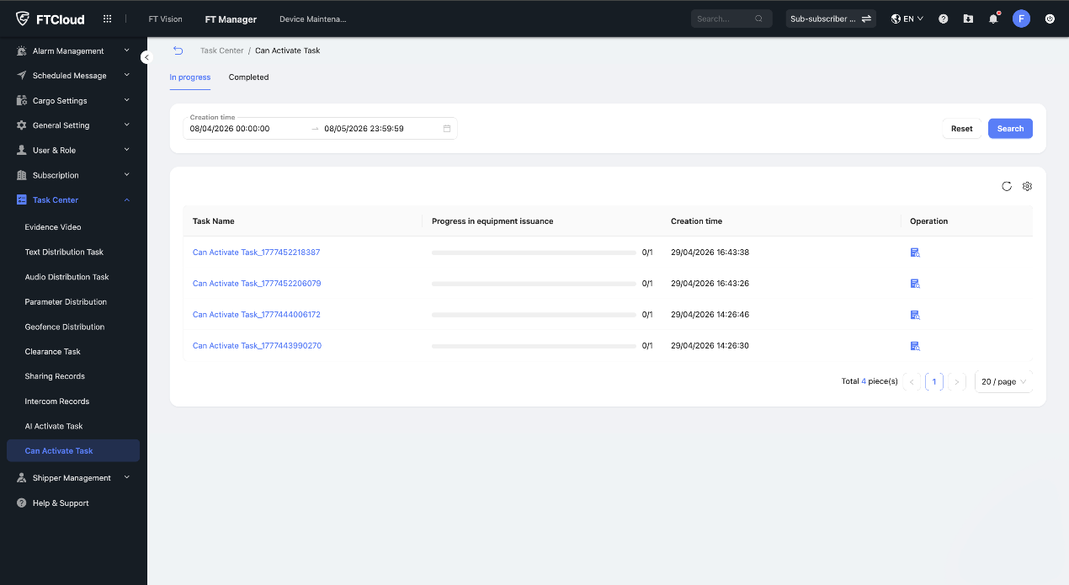
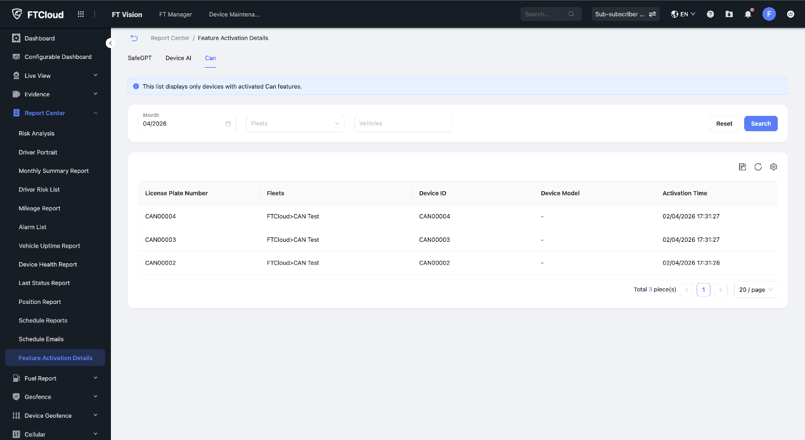
12
11
THE ACTIVATION WORKFLOW
Four screens, start to billing — all inside FT Cloud.
1
2
Single activation
Batch activation
Vehicle Details → CAN Status panel
Vehicle List → More → Batch activation of CAN
3
4
Task progress
Unified billing
FT Manager → Can Activate Task
Report Center → Feature Activation Details
STREAMAX · Inherent CAN Capability
Partner Enablement · 2026

Slide 13
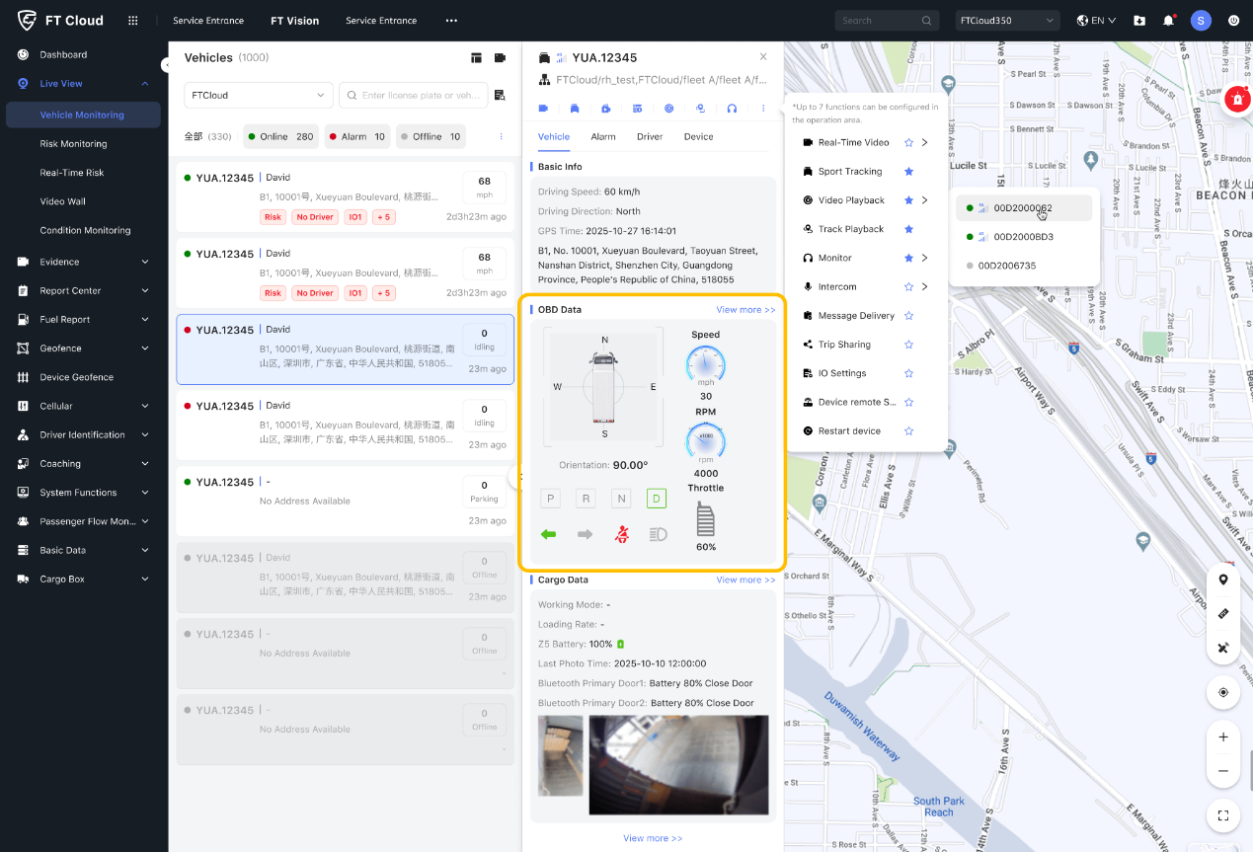
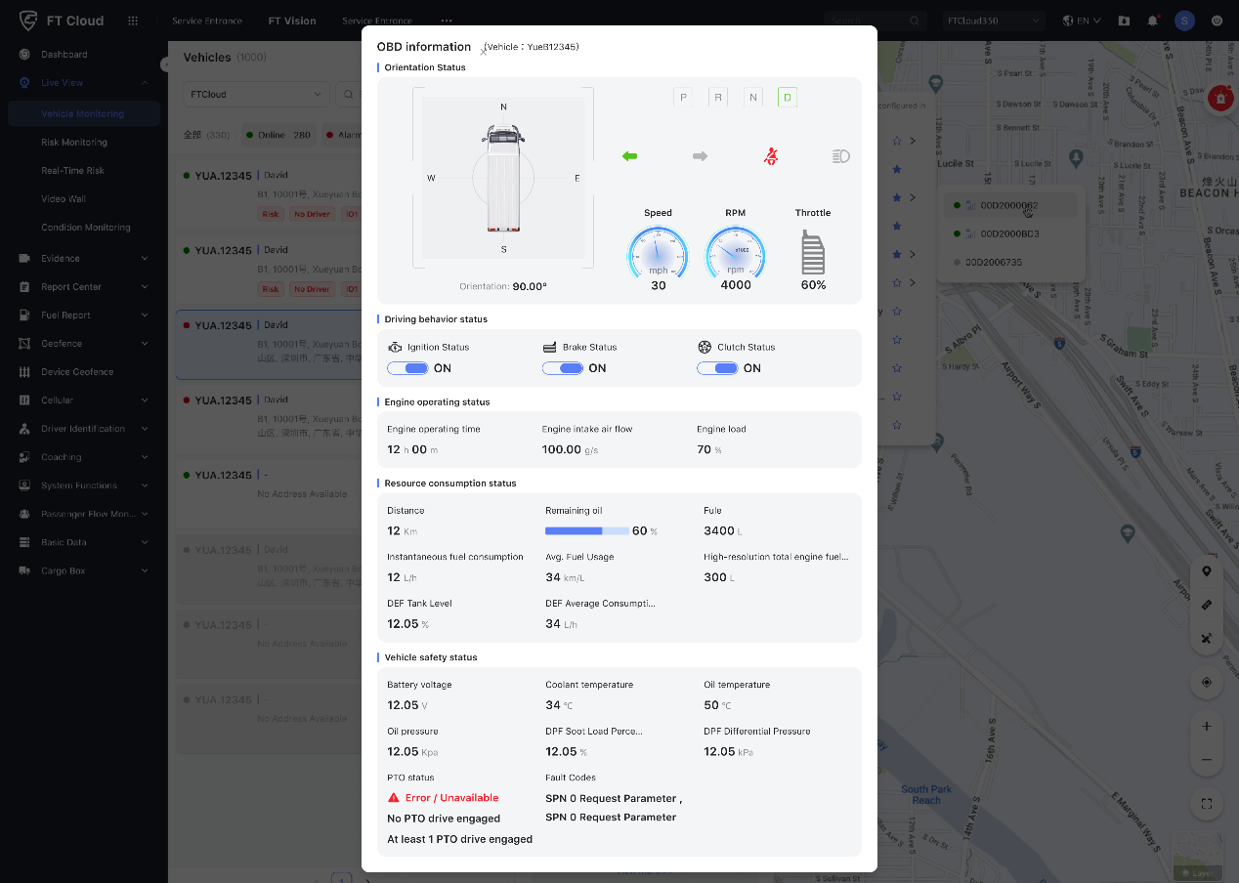
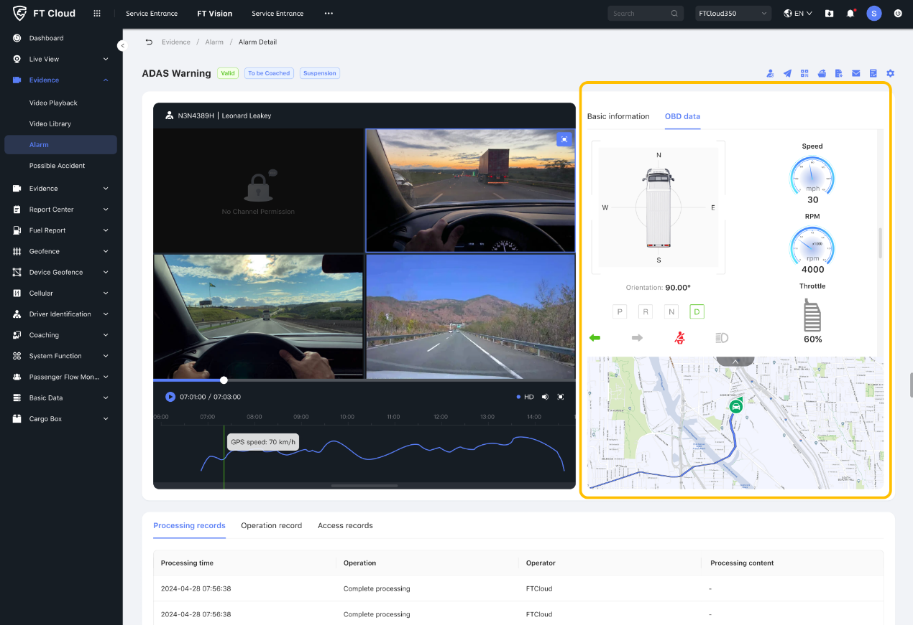
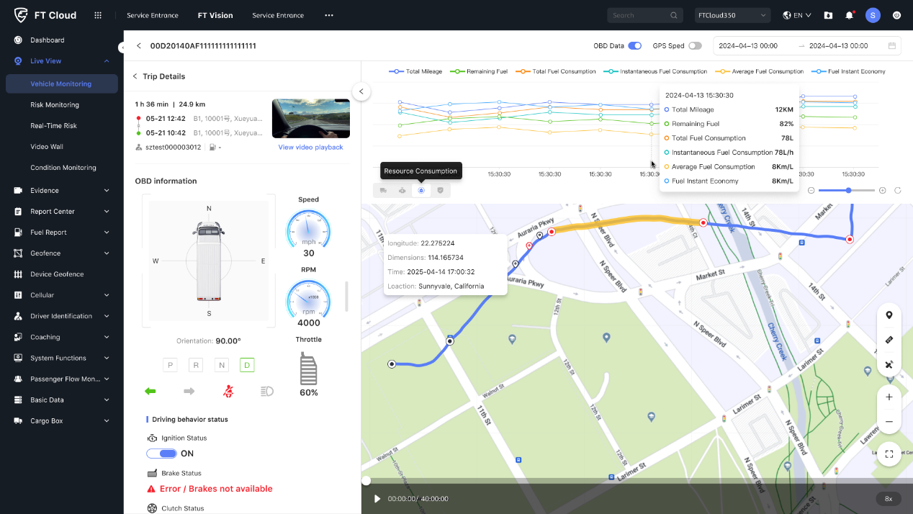
13
12
WHERE CUSTOMERS SEE IT
CAN data lands right next to the video they already trust.
Live OBD panel
Full parameter view
ADAS + OBD
Trip playback
Live View → Vehicle Monitoring — real-time CAN readout
OBD Information modal — every decoded value at a glance
Alarm Detail — video evidence linked to CAN context
Fuel & mileage chart with OBD timeline over the route
STREAMAX · Inherent CAN Capability
Partner Enablement · 2026

Slide 14
14
13
YOUR PLAYBOOK
How to position it — and answer the four questions you'll get.
THE 30-SECOND PITCH
“Your AD Plus 2.0 dashcam already reads the vehicle bus — there's no separate tracker and no CAN box to fit. Turn on the CAN license for $20 instead of a $60 device, activate it remotely from FT Cloud, and you get fuel, engine, driver-behaviour and fault-code data across 3,000+ vehicles — right beside the video.”
Q Do we need new hardware?
Q How is it activated?
A No. AD Plus 2.0 covers it — the CAN library is part of the firmware. No tracker, no external CAN box.
A Self-serve in FT Cloud — single device or batch. Status under FT Manager → Can Activate Task.
Q How is it billed?
Q What if a vehicle isn't listed?
A Per-device, accrued under Report Center → Feature Activation Details — same model as Safe GPT & Device AI.
A Two paths — wait for the annual coverage release, or commission an on-demand adaptation.
If you only get one line out: “Built-in CAN on the Streamax dashcam — $20 license, activated remotely, no extra hardware.”
STREAMAX · Inherent CAN Capability
Partner Enablement · 2026

Slide 15


LET'S ATTACH CAN TO YOUR NEXT DEAL
Built-in CAN, ready to sell.
Bring us a target fleet or a vehicle list — we'll confirm coverage, scope the activation, and set you up to quote the $20 CAN license against the $60 device it replaces.
Coverage check
Activation guide
Your contact
Send the vehicle make / model / year list
FT Cloud V3.18.2 — CAN activation walkthrough
Streamax Product / Solutions team
STREAMAX
STREAMAX · Inherent CAN Capability
Partner Enablement · 2026

